Slide 1

Introduction to Generative AI Models

Slide 2






Engage and Think
What if Generative AI could craft a tailored educational experience for each student, adjusting content and methods based on individual learning styles? How could it impact the way they learn?

Slide 3



Learning Objectives
By the end of this lesson, you will be able to:
Define the key principles of Generative AI and its significance. Differentiate Generative AI from Traditional AI and highlight their
applications.
Explain the functioning of prominent Generative AI models like VAEs, GANs, and transformers.
Explore the practical application of the retrieval augmentation generation (RAG) concept.

Slide 4
Importance of Generative AI

Slide 5
Generative AI Is Crucial for Several Reasons
Generative AI is a subset of artificial intelligence that focuses on creating
models capable of generating new content, such as text, images, music, and more.
Creativity and innovation
Automation and efficiency
Personalization and problem- solving
Industry applications

Slide 6



Creativity and Innovation
Drives advancements in art, design, and product development
Fosters creativity and innovation
Creates novel content for various fields
Empowers content creators, designers, and innovators

Slide 7




Automation and Efficiency
Automates various tasks
Enhances efficiency, saves time, and reduces costs
Excels in tasks like content generation and data analysis
Excels in business, finance, and research

Slide 8


Personalization and Problem-Solving
Tailors content to individual preferences
Enhances user experiences in various applications
Assists in complex problem-solving, such as healthcare
Learns and adapts, refining its capabilities over time

Slide 9
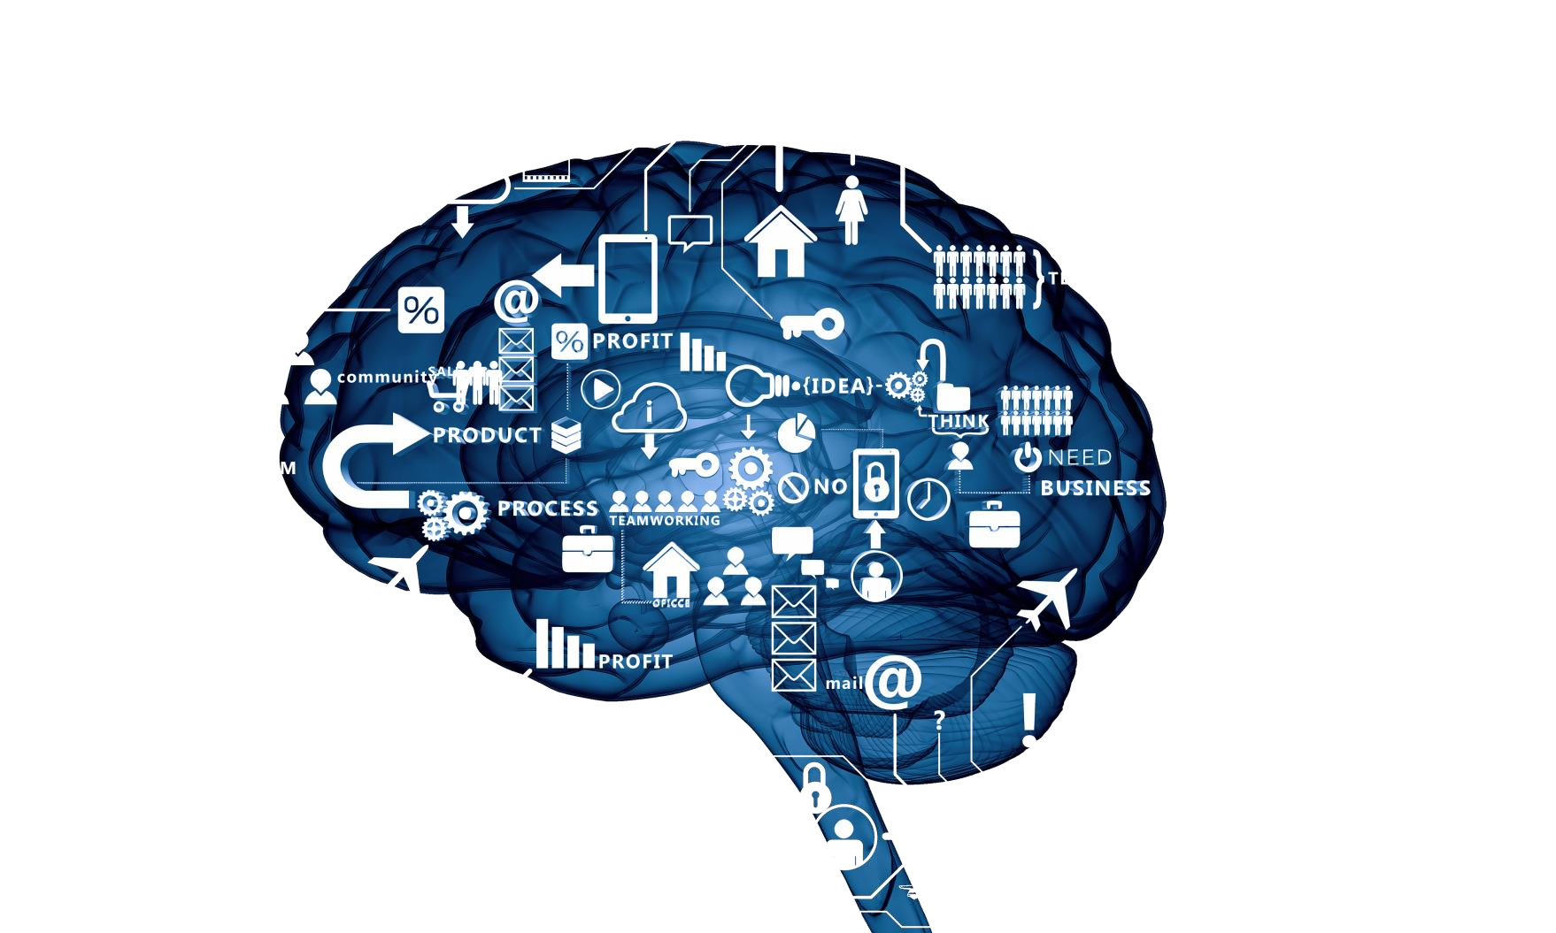
Industrial Significance
Generative AI is widely applicable across industries. It's revolutionizing how we interact with technology
and data. However, ethical considerations, such as privacy and misuse, must be addressed.

Slide 10

Industrial Significance Examples
Entertainment: Creating scripts, music, and virtual actors
Art:
Creating unique digital art and designs
Healthcare: Assisting in drug discovery and personalized medicine
Language translation: Generating translations and transcriptions
Finance:
Risk assessment, fraud detection, and algorithmic trading
Marketing:
Crafting personalized ads and content

Slide 11
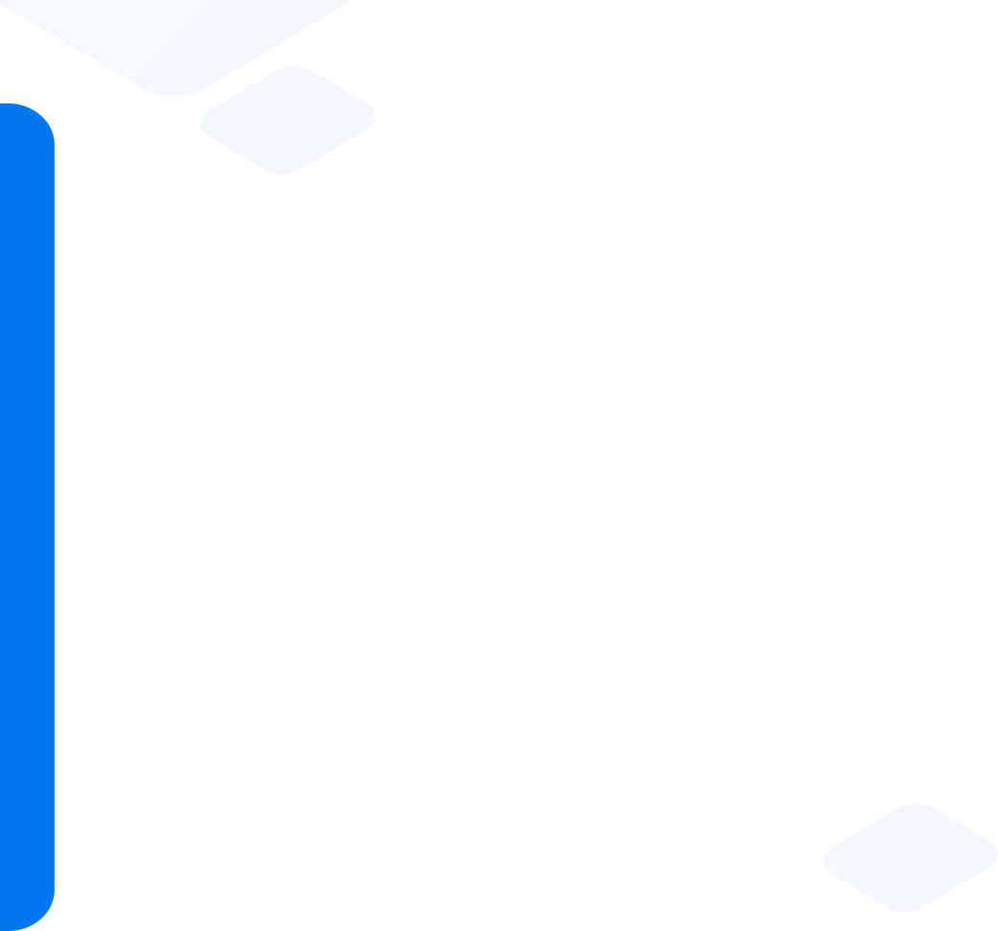

Quick Check
In which industry does Generative AI assist in suggesting potential compounds for various diseases and personalize treatment plans based on patient data and medical history?
Healthcare
Marketing and advertising
Entertainment
Radiology

Slide 12
What Is Generative AI?

Slide 13

What Is Generative AI?
Generative AI is like an AI artist that can create new artworks. Just as a painter combines colors and strokes to produce unique paintings, Generative AI combines data and algorithms to generate new content.
It doesn't just follow preset rules; it learns patterns and can
create something entirely new, just like an artist's imagination.

Slide 14




Generative AI Analogy
Think of Generative AI as a chef in a kitchen.
The chef has a set of ingredients (data) and recipes (algorithms).
Similarly, Generative AI uses data and algorithms as ingredients to cook up new content, adding its own creative touch.
Instead of following a fixed recipe, the chef can experiment, create new dishes, and surprise you with unique flavors.

Slide 15
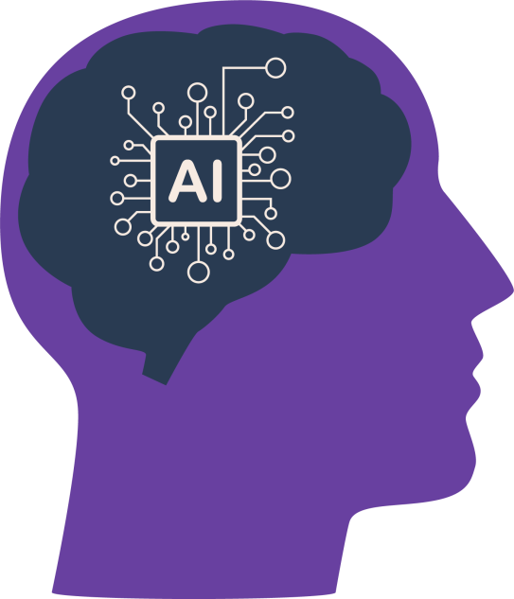

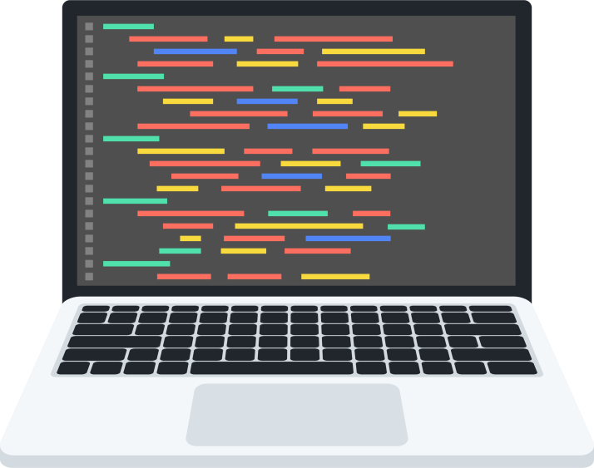
Generative AI vs Traditional AI
Unlike Traditional AI, Generative AI learns patterns and can create novel data,
empowering creativity, innovation, and personalization.
Generative AI
Traditional AI

Slide 16
Generative AI vs Traditional AI
Use case | Generative AI (GenAI) | Traditional AI approaches
Language translation | Achieves state-of-the-art results with models like BERT and GPT-3 | Traditional statistical machine translation systems
Art and design | Creates unique digital art and designs with models like DALL-E | Traditional graphic design tools and artists' creativity
Content generation | Automates content creation for marketing, writing, and more | Requires human input and manual generation
Healthcare | Assists in medical diagnosis, drug discovery, and genomics | Traditional medical data analysis and diagnosis by doctors
Finance | Enhances risk assessment, fraud detection, and algorithmic trading | Rule-based systems and manual analysis

Slide 17
Quick Check
What is the primary difference between Generative AI
and Traditional AI?
Generative AI focuses on learning from data and generating new content, while Traditional AI relies on explicit programming and rule-based systems.
Traditional AI and Generative AI are terms used interchangeably, referring to the same approach in artificial intelligence.
Generative AI is only used for image recognition, while Traditional AI is used for natural language processing.
Traditional AI is a new and experimental field, while Generative AI represents the established, traditional approach in artificial intelligence.

Slide 18
Generative AI Model Types

Slide 19
Generative AI Model Types
Generative AI encompasses various model types, each with distinct characteristics and applications.
Generative adversarial
networks (GANs)
Recurrent neural
networks (RNNs)
Variational
models
Transformers
Autoencoders

Slide 20



Generative AI Model Types
Autoencoders
Recurrent neural
networks
Generative adversarial
networks
Autoencoders, a type of neural network, compress and decode data for tasks such as image generation.
RNNs handle sequences and generate text with LSTM networks for context-based tasks.
GANs, with a generator and discriminator, produce realistic images like StyleGAN.

Slide 21


Generative AI Model Types
Transformers
Variational models
Transformers efficiently handle sequences with self-attention, popular in natural language processing.
Models represent data distribution, enabling sampling. Example: VAEs for diverse images.

Slide 22

Applications of Generative AI Model Types
These diverse model types allow Generative AI to address a wide range of problems and
contribute to innovation across industries.

Slide 23







Applications of Generative AI Model Types
Different types of Generative AI models are used in various fields.
Autoencoders
Variational models
Transformers
Used in image denoising, dimensionality reduction, and anomaly detection in healthcare
Applied in image synthesis, data augmentation, and
semi-supervised learning
Essential for machine translation, chatbots, and text summarization
Recurrent neural
networks
Applied in text generation, language translation, and speech recognition systems
Generative
adversarial networks
Used for image-to-image translation and creating deep fake videos

Slide 24
Quick Check
What type of Generative AI model excels in image generation?
Generative adversarial network
Autoencoder
Transformer
Variational model

Slide 25
VAE, GAN, and Transformer-Based Models

Slide 26
Variational Autoencoders (VAEs)
Variational autoencoders (VAEs) are a type of generative model used in machine learning.
They are proficient at data compression and generation tasks.
VAEs consist of two primary components: an encoder and a decoder.
The encoder compresses input data into a lower-dimensional
representation called the latent space.

Slide 27
Variational Autoencoders (VAEs)
The decoder then reconstructs data from this latent space.
VAEs are unique because they introduce a probabilistic approach to
data compression.
This probabilistic element allows VAEs to generate new data samples from the latent space, offering a powerful tool for creative tasks and data generation.

Slide 28


Real-World Analogy: VAEs in Image Compression
Imagine you have high-resolution images (your data).
You want to save storage space without losing too much quality.
Encoder
Decoder
Compressed data

Slide 29
Real-World Analogy: VAEs in Image Compression
VAEs work like a magic photo album:
You take your photos (images) and put them into the album (encoding).
The album captures the essence of your photos while reducing the size.
When you want the original photo, the album helps recreate it (decoding).
VAEs balance the need for efficient storage (smaller album) with the ability to
recover the original images.
Note
In industries like e-commerce, using VAEs for image compression can save server
space and improve website loading times without compromising image quality.

Slide 30

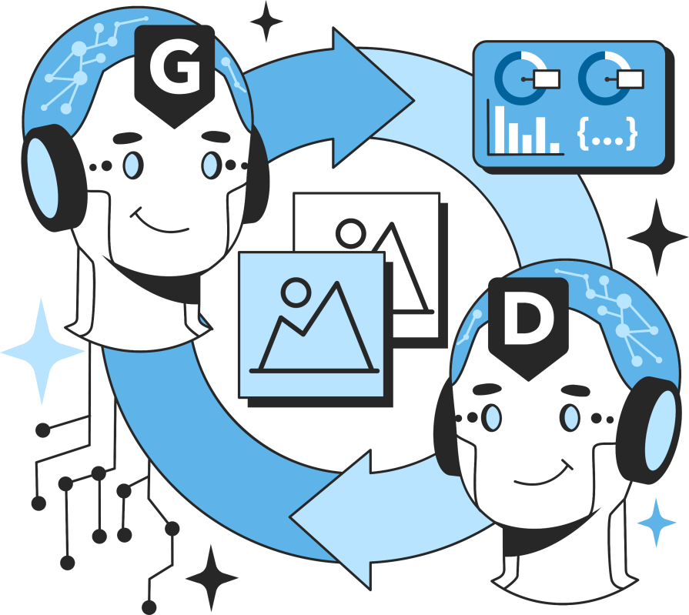
Generative Adversarial Networks (GANs)
Generative adversarial networks (GANs) represent
a revolutionary concept in Generative AI.
The generator's role is to create synthetic data, while the discriminator's task is to differentiate between real and fake data.
GANs have been remarkably successful in generating realistic images, text, and more, making them a cornerstone of Generative AI.

Slide 31
Generative Adversarial Networks (GANs)
GANs consist of two neural networks: a generator and a
discriminator.
These networks engage in a constant game of one- upmanship, with the generator trying to create data that is indistinguishable from real data and the discriminator trying to become better at detecting fakes.
GANs have found applications in diverse fields, such as creating deepfake videos, enhancing image resolution, drug discovery, and material design.

Slide 32

Real-World Impact of GANs: Deepfake Technology
Let's delve into a notable real-world example: Deepfake technology
Deepfakes result from the remarkable capabilities of GANs.
They involve superimposing one person's face onto another person's body in videos, making it look convincingly real.

Slide 33
Real-World Impact of GANs: Deepfake Technology
GANs, with their adversarial training, excel at creating these forgeries.
While deepfake technology has raised concerns about misinformation and privacy, it also has promising applications in the entertainment and film industry.
Note
GANs continue to evolve and are making waves in fields like healthcare, art, and
more, demonstrating their versatility and creative potential.

Slide 34
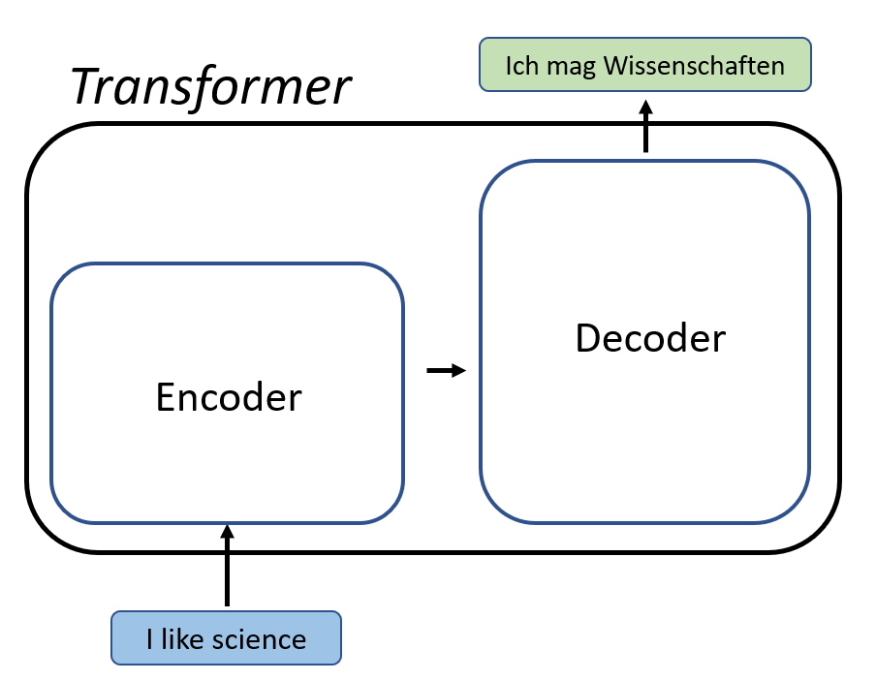
Transformer-Based Models
Transformer-based models revolutionize language processing, enabling advanced tasks such
as translation, summarization, and natural language understanding.

Slide 35

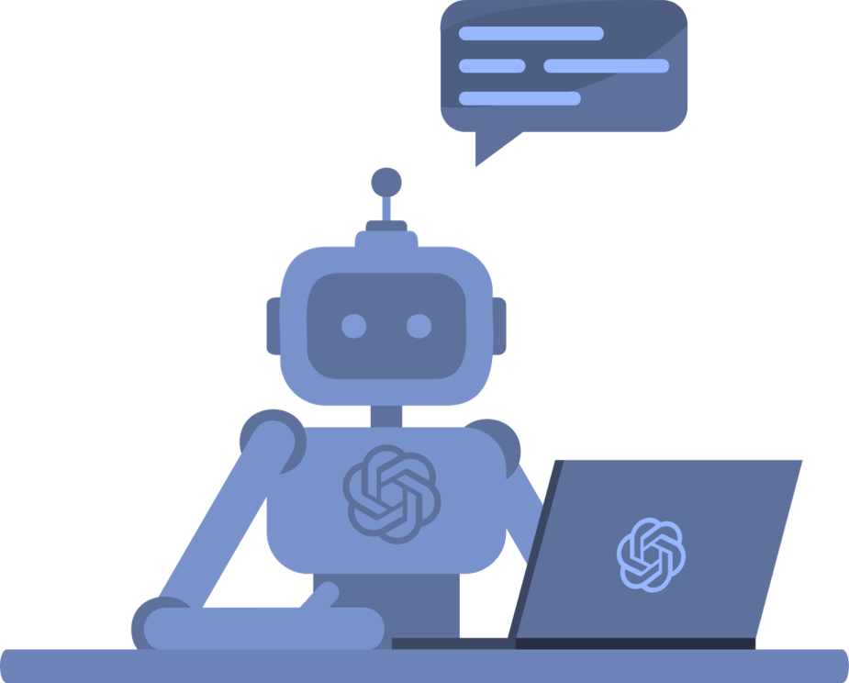
Transformer-Based Models
Transformer-based models are a revolutionary development
in the field of natural language processing (NLP).
They were introduced in the paper Attention Is All You Need by Vaswani and others in 2017.
Unlike traditional sequence models, transformers do not rely on recurrent layers, making them highly parallelizable.

Slide 36
Transformer-Based Models
Transformers utilize a mechanism called self-attention to process input data in parallel, capturing dependencies between words in a sentence.
This self-attention mechanism allows transformers to outperform previous models in various NLP tasks.
Transformer-based models, such as the GPT-3 and BERT, have significantly impacted the way one understands and generate human language.

Slide 37

Real-World Impact of Transformers: Language Translation
One practical example of transformer-based models is their use in language translation.
Traditional translation models required a fixed vocabulary and struggled
with context in long sentences.
Transformers, however, can handle translations at the word level and maintain context effectively.

Slide 38
Real-World Impact of Transformers: Language Translation
They have powered services like Google Translate, improving the quality and fluency
of translations.
This has made cross-language communication more accessible and accurate,
benefitting international business, travel, and online content.
Note
Transformer-based models continue to revolutionize NLP and have a wide range of
applications, including chatbots, content summarization, and sentiment analysis.

Slide 39
Quick Check
Which type of Generative AI model is often utilized for generating human-like text and coherent paragraphs?
Transformer-based model
CNN (Convolutional Neural Network)
VAE (Variational Autoencoder)
LSTM (Long Short-Term Memory)

Slide 40
How Generative AI Works?

Slide 41



How Generative AI Works?
At the heart of Generative AI are neural networks, specifically recurrent neural networks (RNNs) and transformers.
These networks process and generate data by learning patterns from vast
amounts of training data.
RNNs are suited for sequential data, while transformers excel at parallel processing.
These networks form the foundation of generative models.
The working operation of Generative AI involves training models, generating
content, fine-tuning for specific tasks, and assessing model quality.

Slide 42

Training a Generative Model
In training, the model learns to create new examples, like words in a sequence or pixels in an image, for the domain.
This process involves optimizing a set of parameters through backpropagation.
Training may take a significant amount of time and computational resources.
Training a Generative AI model involves exposing it to massive datasets.

Slide 43
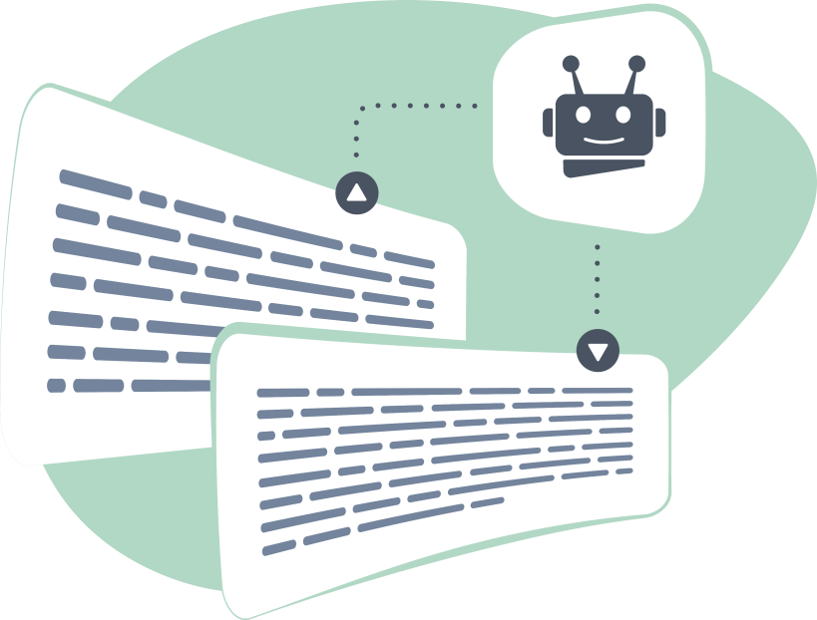
Sampling and Content Generation
It involves choosing the next element or feature based on the model's learned knowledge, whether it's a word in a sequence, a pixel in an image
After training, the model can generate content by sampling from its learned probability distributions.
Sampling temperature is a critical parameter in determining the output's randomness.
It can be done deterministically or stochastically, influencing the output's creativity.

Slide 44





Fine-Tuning for Specialized Tasks
To make the model more useful for specific tasks, fine-tuning is
often applied.
Fine-tuning involves training the model on a narrower dataset, focusing on the task at hand.
This process tailors the model to produce more relevant and specialized outputs.
Fine-tuned models are essential for applications like language translation or summarization.

Slide 45
Quick Check
What neural network type is well-suited for processing sequential data in Generative AI?
Transformer-based model
GAN
RNN
CNN

Slide 46
Evaluating Model Quality in Generative AI

Slide 47



Evaluating Model Quality in Generative AI
Assessing the quality of content generated by Generative AI models is vital for choosing the right model
and identifying areas for improvement.
Selecting the right model for a task is crucial, given the distinct strengths and weaknesses of
Generative AI models. One may excel in image generation, another in coherent text.
Evaluating generative models is essential for selecting the best fit for a task and improving overall AI system success. It guides choices and enables model refinement for
specific requirements.

Slide 48
Evaluating Model Quality in Generative AI
Three main requirements must be met when evaluating generative models:
Diversity
2
Quality
Speed
3
1

Slide 49



Evaluating Model Quality in Generative AI
Speed
Diversity
Quality
Interactive applications, like
real-time image editing, require swift
generation. The model's
speed is crucial in
evaluating its efficacy.
A quality generative
model captures the
full data range, maintaining diverse outputs, minimizing biases, and ensuring balanced results.
Quality matters, especially in user-facing applications. Poor speech or image quality hinders understanding
and usability.in user-facing

Slide 50
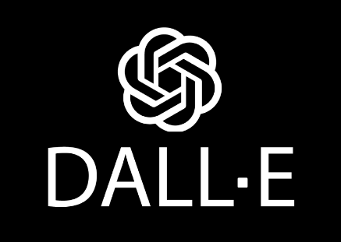
Example: DALL-E
DALL-E is an innovative generative model by OpenAI, creating diverse and imaginative images based on
textual descriptions, showcasing the potential of Generative AI in visual creativity.

Slide 51


Example: DALL-E
DALL-E is an illustrative model of Generative AI developed by OpenAI.
It employs a 12 billion parameter transformer architecture.
DALL-E possesses the remarkable ability to craft images from textual descriptions.
Its capabilities span a wide spectrum, from generating highly realistic images
to surrealistic art, all rooted in textual prompts.
Given the prompt "an armchair in the shape of an avocado," DALL-E adeptly generates an image matching the description.

Slide 52
Quick Check
In real-time image editing applications, what is a crucial factor for evaluating the efficacy of a generative model?
Model's architecture
Model's accuracy on training data
Model's speed
Model's interpretability

Slide 53
Retrieval Augmentation Generation (RAG)

Slide 54
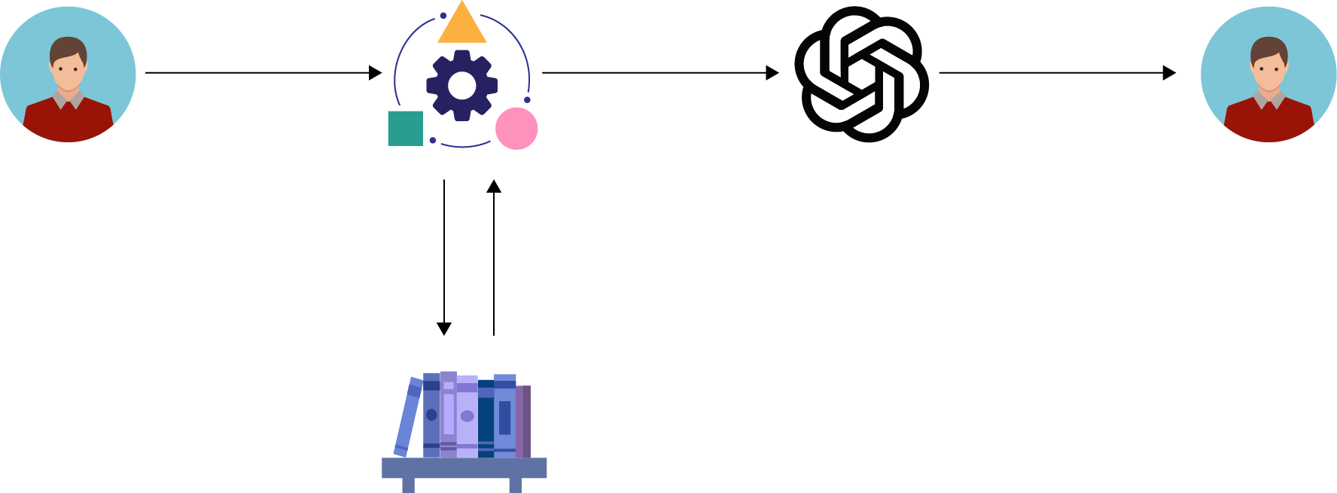
Retrieval Augmentation Generation (RAG)
RAG combines retrieval and generation methods for enhanced natural language processing, leveraging preexisting knowledge while generating contextually relevant information.
Question
Full prompt
Response
Retrieval query
Retrieved text

Slide 55


Retrieval Augmentation Generation (RAG)
Retrieval augmentation generation (RAG) is an advanced concept in natural language processing (NLP).
RAG combines elements of retrieval-based and generative models to enhance AI's capabilities.
RAG is a framework that leverages both retrieval and generation components.
It combines the strengths of models like BERT for retrieval and GPT for generation.
RAG aims to address limitations of purely generative or retrieval-based models.

Slide 56




Components of RAG
RAG consists of three main components:
Retrieval
Augmentation
Generation

Slide 57
Components of RAG
Retrieval
Utilizes pre-trained models to fetch relevant information from large datasets
Augmentation
Enhances retrieved information by paraphrasing, summarizing, or simplifying
Generation
Produces responses or content based on the augmented information

Slide 58



Why RAG Matters?
RAG overcomes limitations of purely generative or retrieval-based systems.
RAG excels in tasks such as answering questions, chatbots, and generating content.
RAG improves response quality and information accuracy by combining these elements.

Slide 59
Quick Check
Which component of Retrieval augmented generation (RAG) is responsible for enhancing retrieved information by paraphrasing, summarizing, or simplifying?
Retrieval
Augmentation
Generation
None of the above

Slide 60
Choice of Retriever

Slide 61

Choice of Retriever
Retrieval Augmented Generation (RAG) empowers Large Language Models (LLMs) to access external knowledge sources, extending their capabilities beyond their pre-trained weights.
RAG utilizes a retriever, which acts as a knowledge scout. This retriever searches external knowledge bases, such as databases, to find relevant documents or information.

Slide 62

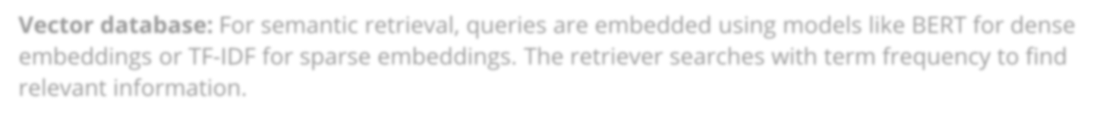


Choice of Retriever
Vector database: For semantic retrieval, queries are embedded using models like BERT for dense TehmebcehdodicinegosfotrheTFr-eIDtrFiefvoerrsdpeaprseendesmobnedthdeinsgpse. cTihfice reqtruieirveemr esenatsr:ches with term frequency to find relevant information.
Graph database: This database structure is employed for knowledge retrieval when data relationships are critical.
Regular SQL database: For structured data, such databases offer a powerful way to access and augment the LLM's knowledge base.

Slide 63

Choice of Retriever
RAG effectively marries the capabilities of an LLM with external knowledge sources, making it a potent
tool for context-aware and knowledge-enriched text generation and understanding.

Slide 64
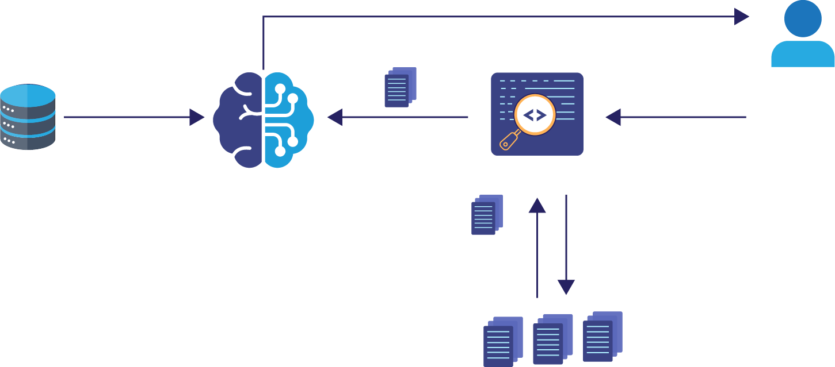
Process of Retrieval Augmented Generation (RAG)
Retrieval augmented generation (RAG) is a multi-step process that seamlessly integrates external
knowledge with LLMs.
Retrieval augmented generation
Response
Query
Query+
Pre-training
User
Massive
dataset
Retrieval model
Pre-trained
LLM
Relevant
docs
Search
Knowledge base

Slide 65
Process of Retrieval Augmented Generation (RAG)
Vector database creation:
RAG begins by converting data into vectors, which is essential for quick retrieval.
User input
Information retrieval:
Database is scanned for segments like user’s
query for
matching.
Combining data:
Generating text:
Users ask questions in plain language, often seeking answers
or completion.
Chosen database segments combine with user's query for an enriched prompt.
Expanded prompt with added context guides LLM to create relevant response.

Slide 66
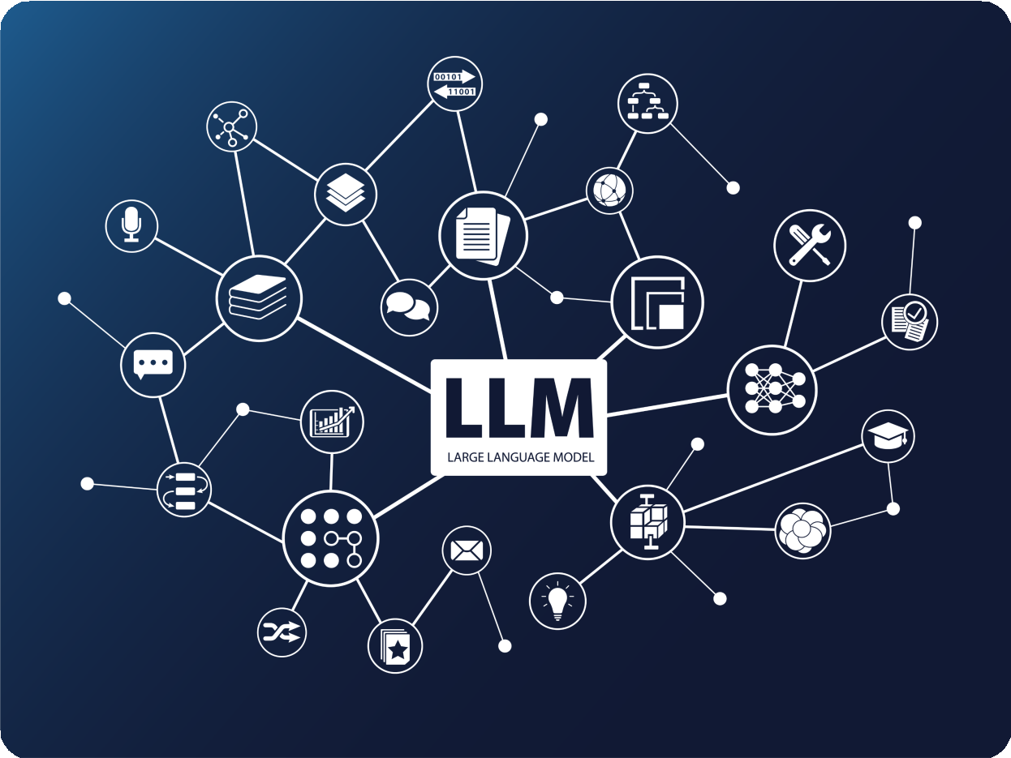
Process of Retrieval Augmented Generation (RAG)
This process seamlessly integrates external knowledge sources, enhancing the large language model's
ability to provide more accurate and contextually rich responses to user queries.

Slide 67
Real-World Applications of RAG
RAG has practical applications in various fields:
Customer support chatbots that provide accurate and context-aware responses
Search engines that understand user queries and generate informative snippets
Content generation for news articles, product descriptions, and more

Slide 68
Quick Check
Which type of database structure is typically employed for knowledge retrieval when data relationships are crucial?
Vector database
Graph database
Regular SQL database
NoSQL database

Slide 69
Emerging Trends

Slide 70
Emerging Trends
Generative AI is evolving, giving rise to emerging trends shaping modern applications. Let's explore
these key trends and their impact.
Cross model learning
Streaming
k-means
Few-shot learning
Streaming k-means
Responsible AI development
Power iteration clustering (PIC)

Slide 71






Guided Practice
Overview Duration: 20 minutes
In this activity, test your understanding of the different generative model types covered in this module. A scenario will be given with a list of generative model types, and you will have to choose the most suitable one for the scenario. Also, explain why you chose that model type and how it works.
Note
Please download the solution document from the Reference Material Section and follow the Jupyter Notebook for step-by-step execution.

Slide 72

Key Takeaways
Generative AI includes different types of models, each with unique traits and uses.
Autoencoders, a neural network type, condense and decode data,
serving tasks like generating images.
Generative AI revolutionizes technology interaction but demands ethical attention to aspects like privacy and misuse.
RAG enhances language processing by blending retrieval and generation, using existing knowledge for contextually relevant information.

Slide 73


Additional Resources
Nah, F. F., Zheng, R., Cai, J., Siau, K., & Chen, L. (2023). Generative AI and ChatGPT: Applications, challenges, and AI-human collaboration. Journal of Information Technology Case and Application Research, 25(3), 277– 304. https://doi.org/10.1080/15228053.2023.2233814
Bandi, A., Adapa, P. V. S. R., & Kuchi, Y. E. V. P. K. (2023). The power of Generative AI: a review of requirements, models, Input–Output formats, evaluation metrics, and challenges. Future Internet, 15(8), 260. https://doi.org/10.3390/fi15080260

Slide 74
Q&A

